Slide 1
JQuery

Slide 2
What is Jquery ?
jQuery is a JavaScript Library.
JQuery is a lightweight, "write less, do more", JavaScript library.
The purpose of jQuery is to make it much easier to use JavaScript on your website.
An open source JavaScript library that simplifies the interaction between HTML and JavaScript.
Jquery is easy to learn and master.

Slide 3
What you should already know?
HTML
CSS
JavaScript

Slide 4
Installing JQuery
Steps for adding Jquery to your web pages :
The jQuery library is a single JavaScript file, and you reference it with the HTML <script> tag inside the <head> section.
<head> <script src="jquery-3.7.1.min.js"></script> </head>
Place the downloaded file in the same directory as the pages where you wish to use it.

Slide 5
Installing JQuery
jQuery from CDN
If you don't want to download and host jQuery yourself, you can include it from a CDN (Content Delivery Network).
<head> <script src="https://ajax.googleapis.com/ajax/libs/jquery/3.7.1/jquery.min.js">
</script> </head>

Slide 6
jQuery Syntax
With jQuery you select (query) HTML elements and perform "actions" on them.
Basic syntax is: $(selector).action()
A $ sign to define/access jQuery
A (selector) to "query (or find)" HTML elements
A jQuery action() to be performed on the element(s)
Examples:
$("p").hide() - hides all <p> elements.
$("#test").hide() - hides the element with id="test".
$(".test").hide() - hides all elements with class="test".

Slide 7
The Document Ready Event
$(document).ready(function(){ // jQuery methods go here... });
This is to prevent any jQuery code from running before the document is finished loading (is ready).
Trying to hide an element that is not created yet
Trying to get the size of an image that is not loaded yet

Slide 8
Alternate Syntax
$(function(){ // jQuery methods go here... });
Use the syntax you prefer.

Slide 9
Jquery Selectors
jQuery selectors allow you to select and manipulate HTML element(s).
With jQuery selectors you can find elements based on their id, classes, types, attributes, values of attributes and much more. It's based on the existing CSS Selectors, and in addition, it has some own custom selectors.
All type of selectors in jQuery, start with the dollar sign and parentheses: $().
Types of jquery selectors :
Element selector
Id (#) selector
Class (.) selector

Slide 10
Element Selector
The jQuery element selector selects elements based on their tag names.
Example :
$(document).ready(function(){ $(“button").click(function(){ $("p").hide(); }); });

Slide 11
Id (#) Selector
The jQuery #id selector uses the id attribute of an HTML tag to find the specific element.
An id should be unique within a page, so you should use the #id selector when you want to find a single, unique element.
Example :
$(document).ready(function(){ $(“button").click(function(){ $("#test").hide(); }); });

Slide 12
Class (.) Selector
The jQuery class selector finds elements with a specific class.
Example :
$(document).ready(function(){ $(“button").click(function(){ $(".test").hide(); }); });

Slide 13
More Jquery Selectors
Syntax | Description
$("*") | Selects all elements
$(this) | Selects the current HTML element
$("p.intro") | Selects all <p> elements with class="intro"
$("p:first") | Selects the first <p> element
$("ul li:first") | Selects the first <li> element of the <ul>
$("ul li:first-child") | Selects the first <li> element of every <ul>
$("[href]") | Selects all elements with an href attribute
$("a[target='_blank']") | Selects all <a> elements with a target attribute value equal to "_blank"
$("tr:even") | Selects all even <tr> elements
$("tr:odd") | Selects all odd <tr> elements

Slide 14
Jquery Effects
jQuery hide() , show(), toggle()
Syntax:
$(selector).hide(speed, callback); $(selector).show(speed, callback);
$(selector).toggle(speed, callback);
The optional speed parameter specifies the speed of the hiding/showing, and can take the following values: "slow", "fast", or milliseconds.

Slide 15
Jquery Fading Methods
With jQuery you can fade an element in and out of visibility.
jQuery has the following fade methods:
fadeIn() : used to fade in a hidden element
fadeOut() : used to fade out a visible element
fadeToggle() : toggle between fade in and fade out
fadeTo() : used to fade element to opacity value (0 and 1)
Syntax :
$(selector).fadeIn(speed, callback);
$(selector).fadeOut(speed, callback);
$(selector).fadeToggle(speed, callback);
$(selector).fadeTo(speed, callback);

Slide 16
Jquery Effects : Sliding
With jQuery you can create a sliding effect on elements.
jQuery has the following slide methods :
slideDown() : used to slide down an element
slideUp() : used to slide up an element
slideToggle() : toggles between the slideDown() and slideUp()
Syntax :
$(selector).slideDown(speed, callback);
$(selector). slideUp(speed, callback);
$(selector).slideToggle(speed, callback);

Slide 17
Jquery Effects : Animation
The jQuery animate() method lets you create custom animations.
Syntax :
$(selector).animate( { params }, speed, callback);
The required params parameter defines the CSS properties to be animated.
The optional speed parameter specifies the duration of the effect. It can take the following values: "slow", "fast", or milliseconds.
The optional callback parameter is the name of a function to be executed after the animation completes.
By default, all HTML elements have a static position, and cannot be moved. To manipulate the position, remember to first set the CSS position property of the element to relative, fixed, or absolute!

Slide 18
Jquery Effects :Stop
The jQuery stop() method is used to stop an animation or effect before it is finished.
The stop() method works for all jQuery effect functions, including sliding, fading and custom animations.
Syntax :
$(selector).stop(stopAll , goToEnd );
The optional stopAll parameter specifies whether also the animation queue should be cleared or not. Default is false, which means that only the active animation will be stopped, allowing any queued animations to be performed afterwards.
The optional goToEnd parameter specifies whether or not to complete the current animation immediately. Default is false.
So, by default, the stop() method kills the current animation being performed on the selected element.

Slide 19
Jquery : Callback
A callback function is executed after the current effect is 100% finished.
JavaScript statements are executed line by line. However, with effects, the next line of code can be run even though the effect is not finished. This can create errors.
To prevent this, you can create a callback function.
Syntax :
$(selector).hide(speed, callback);

Slide 20
Jquery : Chaining
With jQuery, you can chain together actions/methods.
Chaining allows us to run multiple jQuery methods (on the same element) within a single statement.

Slide 21
Jquery : Events
All the different visitors' actions that a web page can respond to are called events.
An event represents the precise moment when something happens.
Examples:
moving a mouse over an element
selecting a radio button
clicking on an element

Slide 22
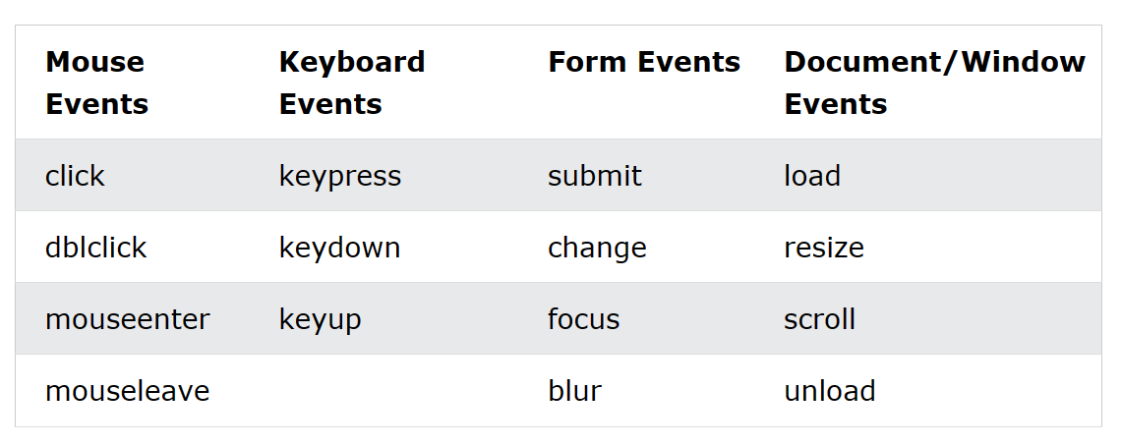
Jquery : Events

